Slide 1
Fighting Hunger with Data
Presented by the Lively Leaflets:
Alok Kommajesula, Aparna Potdar, Kevin Crosby, Trevor Prescott, Raj Ray

Slide 2

Are you tired of eating the same foods every day?
If your meal menu runs on repeat, your body might hit a snag: People who eat the same foods over and over again tend to be less healthy than those who strive for variety, suggests recent research in the Journal of Nutrition.
Source:https://www.menshealth.com/nutrition/a19540574/food-variety-health-benefits/

Slide 3

Gathering reviews from multiple sources
Many restaurant review sites offer businesses the ability to pay for the removal of negative reviews
Difficult to accept one source at face value
Since hungry people aren’t known for their patience, we decided to create an aggregate review site that doesn’t require a huge time investment to navigate

Slide 4
Creating a Database:
First, we gathered data from multiple review sites:
Yelp API
Zomato API
Google Reviews
Using SQL, we created a set of standards and consolidated our data

Slide 5
PLACEHOLDER DATABASE SLIDES-yelp - ALOK

Slide 6
PLACEHOLDER DATABASE SLIDES-yelp - Aparna

Slide 7
PLACEHOLDER DATABASE SLIDES - RAJ

Slide 8
Creating Visualizations
Our visualizations required specific formatting in order to be accepted
A Hierarchy was then built to provide structure to our graphics
Parent and Child nodes were created to link our various data points

Slide 9
Designing an Interface
With convenience in mind, we designed an interface that focused on three fields
Cuisine Type
Price Point
Aggregate Average Review Rating
We wanted to enable three primary functions
Exploratory restaurant navigation (What should I eat today?)
Overview of nearby restaurants (What does my town have to offer?)
Map of my city with Restaurant results

Slide 10
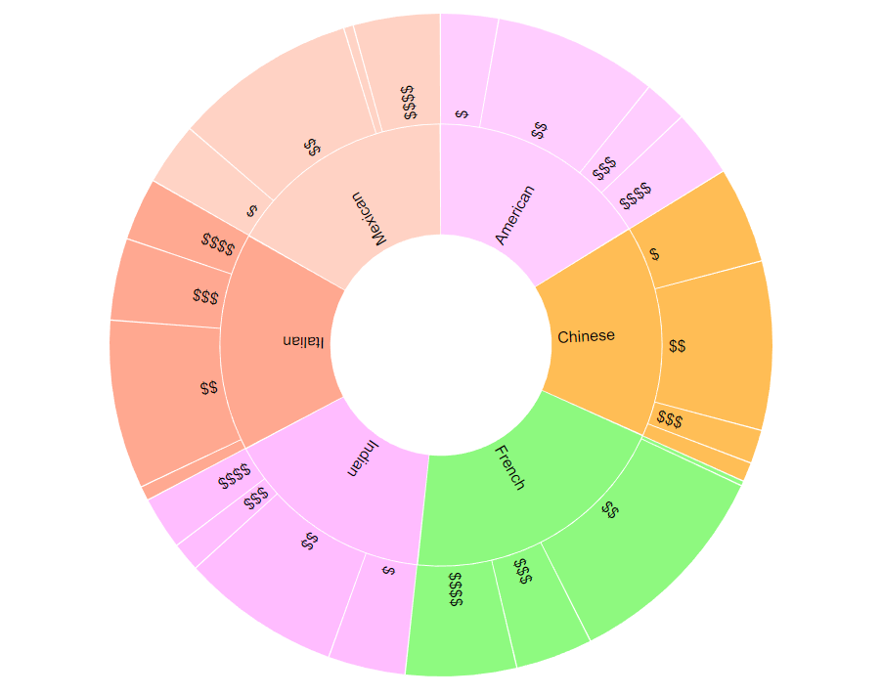
Exploratory Restaurant Navigation

Slide 11
Translating the Data
PLACEHOLDER FOR A COUPLE OF TREVOR’S CODE BLOCKS
Suggestion: show some user interactivity code and code for launching yelp on business name click

Slide 12
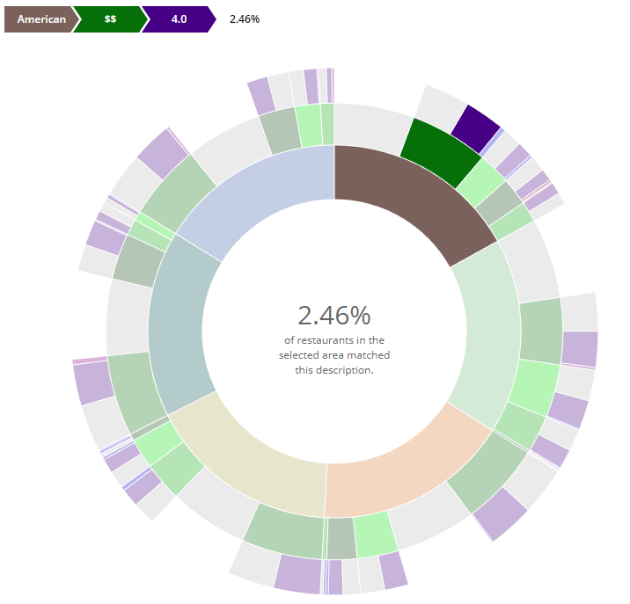
Overview of Nearby Restaurants

Slide 13
Translating the Data
PLACEHOLDER FOR A COUPLE OF KEVIN’S CODE BLOCKS
Show build hierarchy function, python data prep, and breadcrumb builder

Slide 14
Restaurant Mapping
Placeholder for final map picture

Slide 15
Restaurant Mapping
Placeholder for MAP CODE blocks

Slide 16
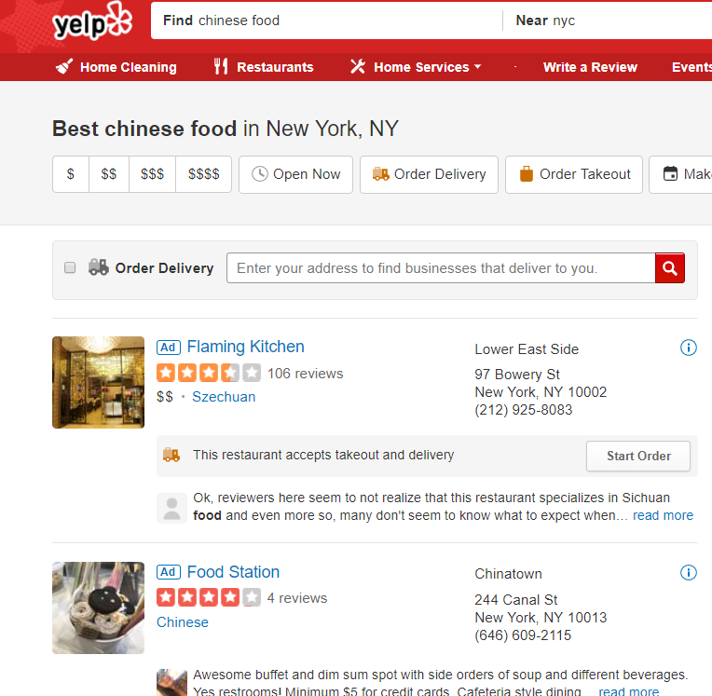
The old way:
Sponsored links(ad) are listed on top, despite often being out of your search range
Requires extremely specific search criteria
Repetitive cycling through pages for each search
More likely to be manipulated by removing negative reviews
Rinse and repeat for various restaurant types, price ranges, ratings, and data sources

Slide 17
LIVE DEMO

Slide 18
Moving forward
APIs:
Due to free API access constraints, our volume was limited. Paid APIs would enable us to list significantly more restaurants and areas
Front-End:
Various interface changes could be made to improve aesthetics and user experience
Heroku Deployment:
Due to locally hosted files, the creation of a virtual server was utilized to access local files

Slide 19
Thanks for your Time!
Go Lively Leaflets!!

